Slide 1

POSEIDON .NET
Thodoris Kapiris
Stavros Kasidis
Anargyros Roussos

Slide 2
Intro
Subjects
Package vs Assembly vs Project references
Directory.Build.props
Global Properties & Package versioning
Common references & Conditions
Project Structure (.csproj) 1 & 2
Poseidon Cross-Platform
Poseidon Windows
Hercules Windows

Slide 3
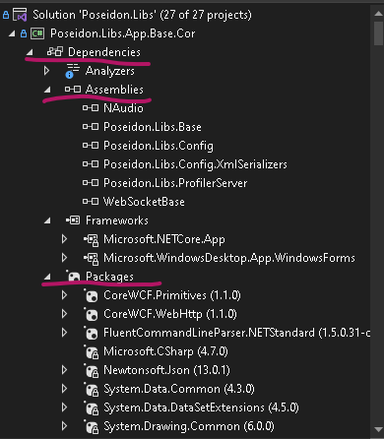
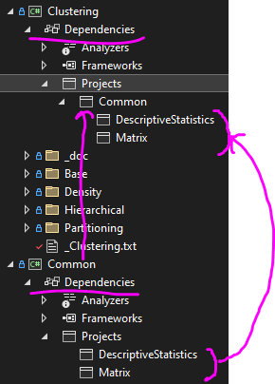
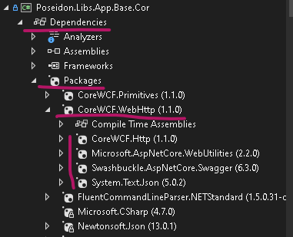
PackAge & ASSEMBLY
REFERENCES
PROJECT
Packages has references
Project has references too
Package references

Slide 4
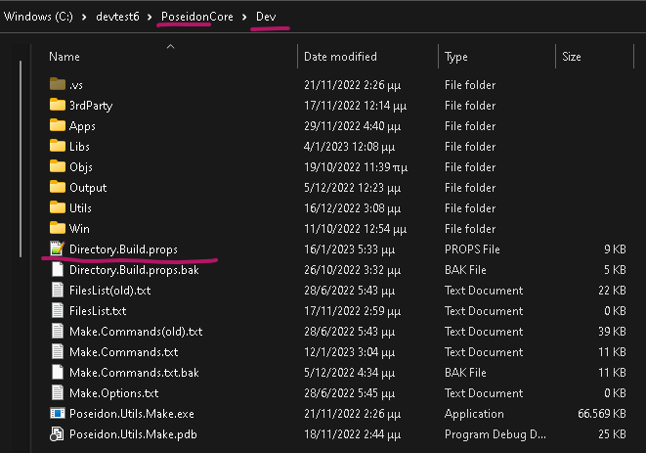
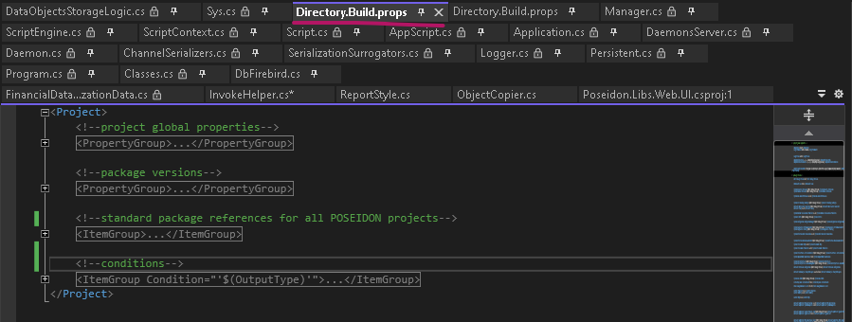
Directory.Build.props
Global properties
Package version
Common package references
Conditions (references)

Slide 5
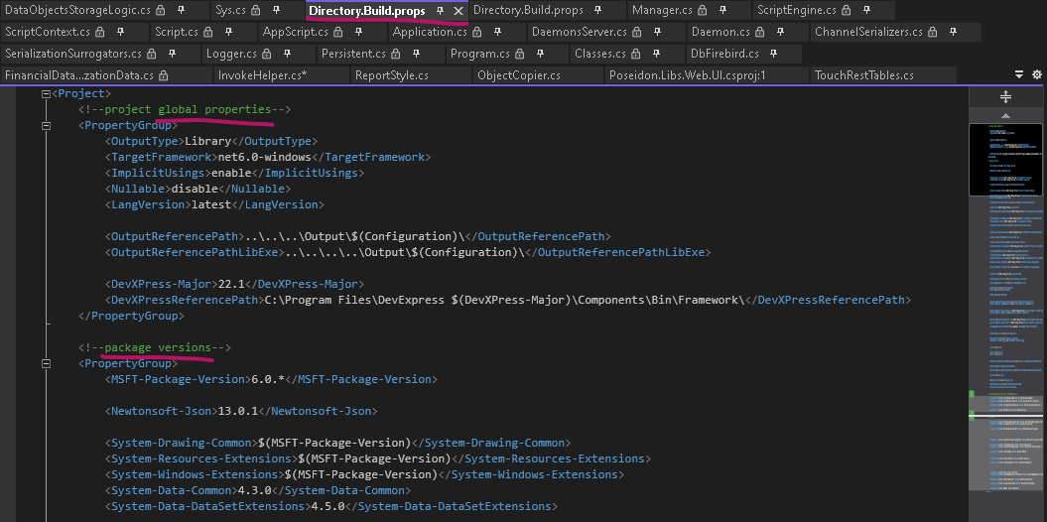
GLOBAL PROPERTIES & PACKAGE VERSIONING
Project Properties
Version Variables
Other variables

Slide 6
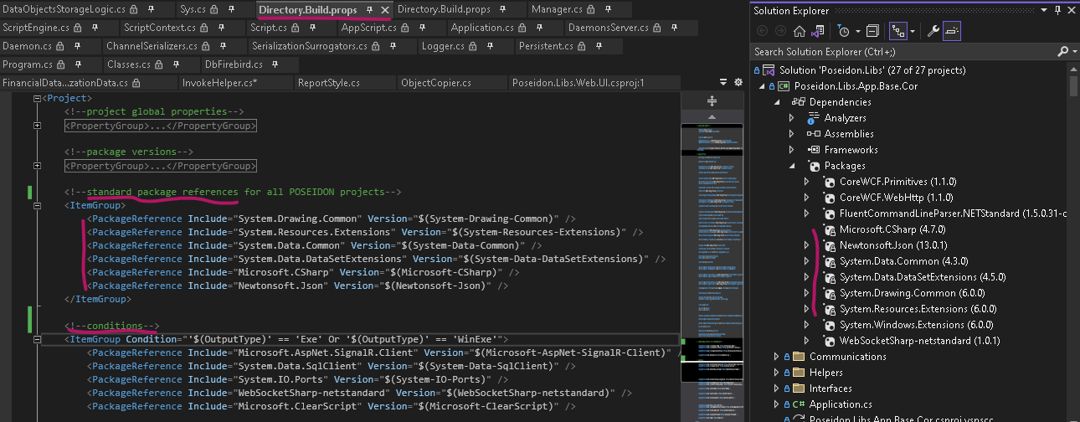
COMMON PACKAGE REFERENCE & Condition PACKAGE REFERENCE
Common package references
Conditional references

Slide 7
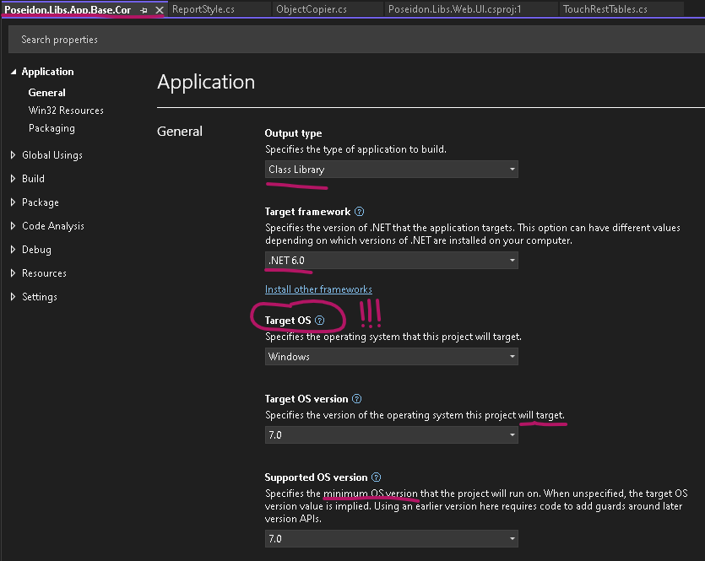
.CSPROJ (1)
Properties
Output type
Target framework (CROSS-PLATFORM)
Target OS (SPECIFIC-PLATFORM)
Poseidon Cross-Platform
3rd Party Libs
Packages (Standard <= 2.0 or .NET 5.0 6.0 …)
Poseidon.Libs.Config
Poseidon.Libs.Base
Poseidon.Libs.Db
Etc.
Hercules Cross-Platform
Objects
Collections
Logic
Poseidon & Hercules Windows (Forms)
All others

Slide 8
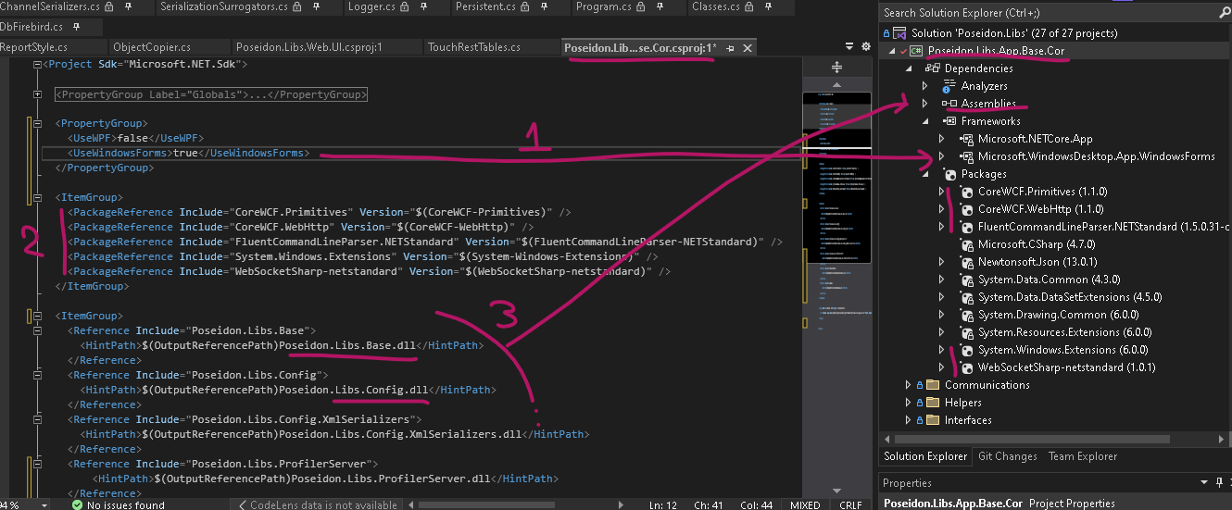
.CsPROJ (2)
Framework added! (not only windows but also WINDOWS FORMS)
Project’s package references
Project’s assembly references

Slide 9
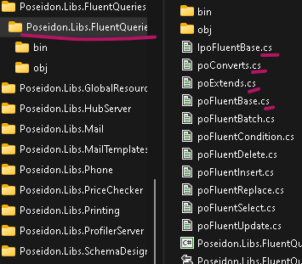
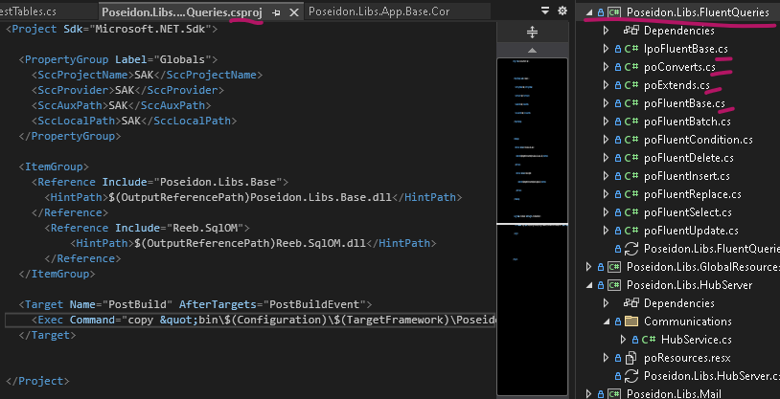
Conclusion
3r Party libraries & assembly references
Package references
.Net Standard 2.0/ .Net 5.0/6.0 etc.
Directory.Build.props
All projects (.csproj) must be changed
Cross-Platform
Windows Platform (Windows Forms)
Important note All files and folders in project (folder) belongs to project!

Slide 10
PoseidON & HERCULES .NET X.0 where x >= 6
Subjects
3rd Party
Poseidon
Hercules
DevXpress
Create project 1 & 2
Conversion Tool (Upg.exe, Ckecks)
Output (Publish)
Build
Executables & Services (WebApplications)

Slide 11
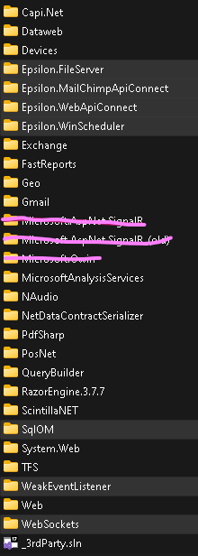
3rd Party
Added
Deprecated
WeakEventListener
NetDataContractSerialize
NetDataContractSerialize
BinarySerializer
WeakEventListener (Windows Forms Only)
.Net Standard 2.0 / Build
WeakEventListener
NetDataContractSerialize
SQLOM & Epsilon.*
WebSockets (client)
Capi.Net ???
Deprecated but … replaced
WCF to CoreWCF
Scripting (CodeDom) to ClearScript
Kept
DataContractSerialize
Kept (assembly references)
Dataweb
Devices (etc)
Important notes
Windows Communication Framework (WCF) may be deprecated in .NET 5/6+, but it doesn’t mean your applications are going to be left out in the cold. The server components that complement the aforementioned client libraries are available through CoreWCF. As of April 2022, CoreWCF is officially supported by Microsoft. However, for an alternative to WCF, consider gRPC.
Package reference
NetDataContractSerializer (NetDCS) writes the type information for all objects, while the DataContractSerializer (DCS) only writes those which need to (i.e., if you declare a member as type B, and the actual value of the member when being serialized is of type D, where D is a derived type from B, so there is a lot less "noise" in a DCS-serialized type. You need to use known types in the DCS, but you can use a DataContractResolver if you don't want to work with known types.
SignalR (Hub)
All others

Slide 12
Poseidon
Added
Moved
Poseidon.Lib.App.Base (Sys & Application from Poseidon.Libs.Base)
Poseidon.Libs.ProfilerServer (Signal-R)
Poseidon.Libs.Client.Cor (Cross-Platform)
All assemblies (Poseidon.Libs.Base)
All listeners (WCF to CoreWCF) to executables
Daemons & Customs
To Executable (Poseison.Console.Server)
Replaced
Poseidon.Libs.Base
Scripting
Modified
Poseidon.Lib.Base
Assembly loading
2nd Domain not supported
Assembly Metadata Investigator
WeakEventListener
Poseidon.Libs.HubServer
Signal-R packages
Binary Serialization
poSys.CommonSerialize & poSys.CommonDeserialize (Surrogators added)
Blob Data (Hercules) must be Jsonconvert
DataContracts keeps it’s serialization (Surrogators added)
Special cases BigDatasets, Imports, Customization

Slide 13
Hercules
Moved
Hercules.Libs.Base)
All listeners (WCF to CoreWCF) to executables
Replaced
Hercules.Libs.Base
Soap with Http
Azure file storage/blob

Slide 14
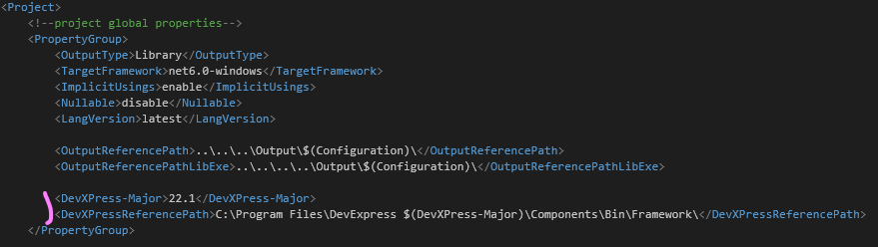
DEVXPRESS
Packages
Special case
Poseidon.Build.Props

Slide 15
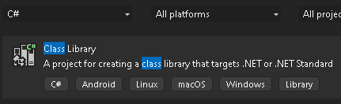
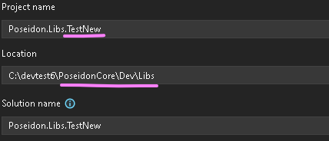
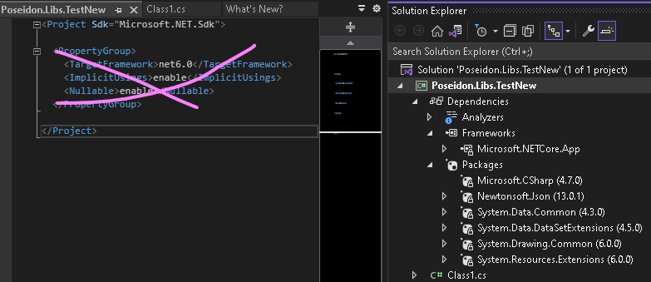
CREATE A PROJECT (1)
Step 1
Step 2
Step 3
Project!

Slide 16
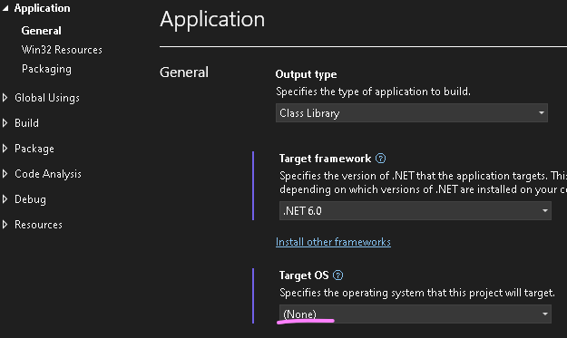
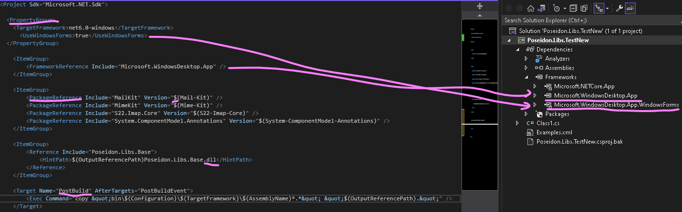
CREATE A PROJECT (2)

Slide 17
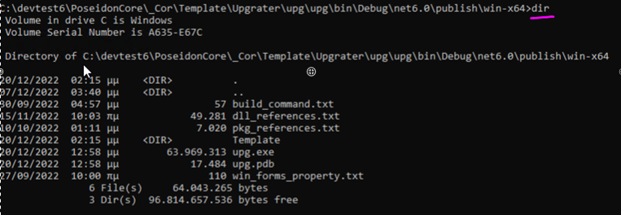
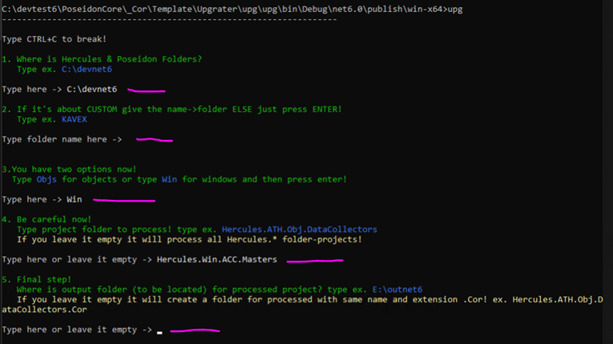
Conversion Tool (.exe)
Steps
Upg.exe

Slide 18
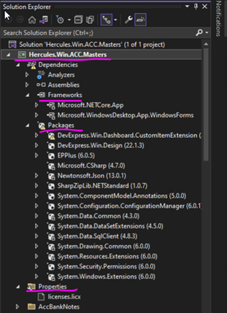
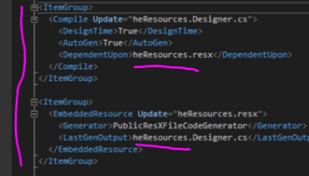
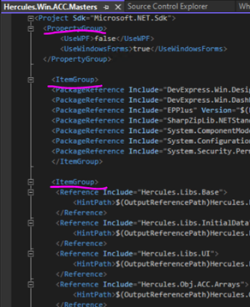
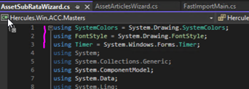
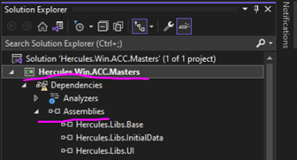
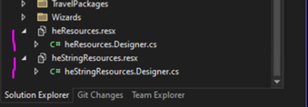
Conversion Tool (result)
Project References (source)
Project References

Slide 19
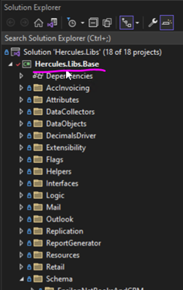
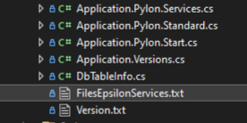
Conversion Tool (CHECK)
Embedded resource (Manual)

Slide 20
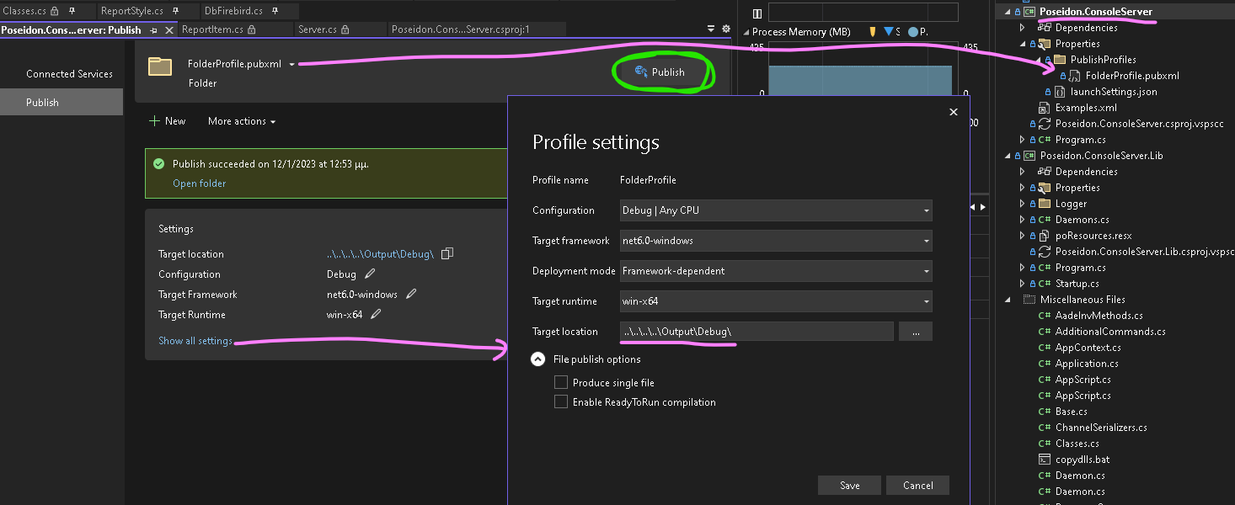
OUTPUT (PUBLISH)
PUBLISH
Create a publish profile (once)
Create the final executed (anytime)

Slide 21
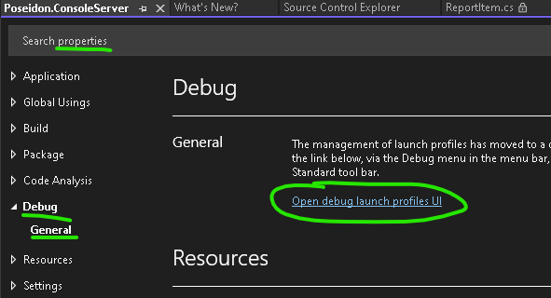
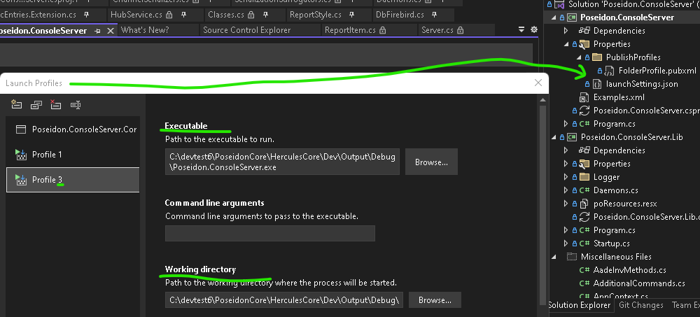
PUBLISH (DEBUG)
Launch Profiles
Debug

Slide 22
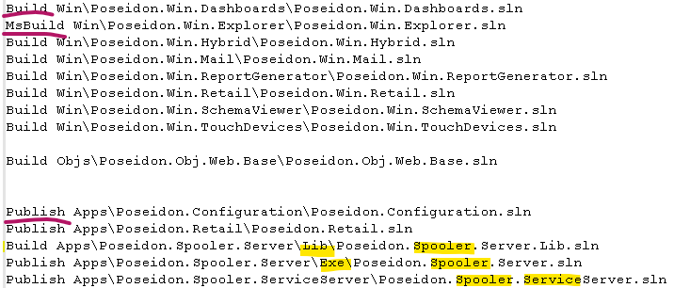
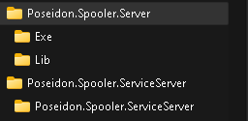
BUILD
Poseidon.Utils.Make.exe
Make commands
Build
MsBuild
Publish
Folders view
Lib (Common for executable & service)
Exe (Executable solution)
Service…. (Windows Service – Selfhost)

Slide 23
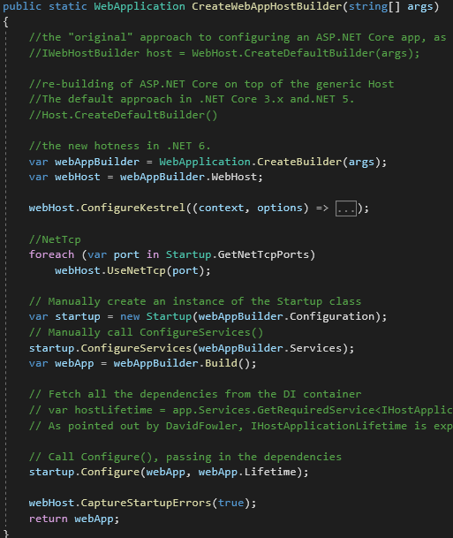
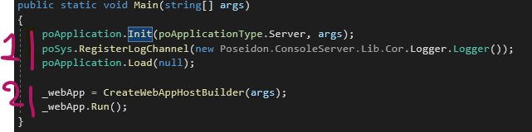
EXECUTABLES
1. Application (Console, WinForms)
2. WebApplication
Builder
Webhost
Kestrel
Startup
Configure Services
Configure

Slide 24
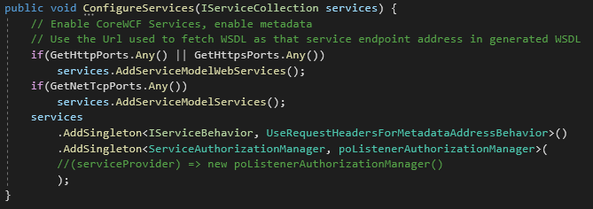
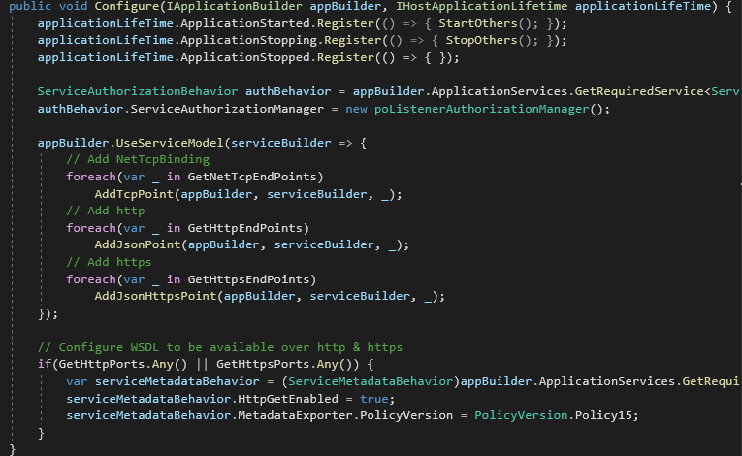
EXECUTABLES
Startup
Configure Services
Configure

Slide 25

PROCESS Service SERIALIZE
Process : Poseidon.ServiceSerialize.exe

Slide 26
FIN

